Slide 1

IOT Enabled Electric Vehicle Monitoring and Control EED4395 – IOT PROJECT ELECTRIC VEHICLE MAINTENANCE SCHEDULING USING ESP32 FINAL REVIEW
Dani N 21113004
Dharshan R E 21113049
SUPERVISORS
Muthukumaran G, Professor

Slide 2
Block Diagram
Sensors
ESP32
Board
CLOUD, OUTPUT

Slide 3
Circuit Diagram
OLED Display
Ultra Sonic Sensor
ESP32
Board
RTC
Module
THING SPEAK

Slide 4
Problem faced and Rectified
Problem Faced | Problem Rectified
Inaccurate Distance Measurements | Implemented proper calibration procedure for the ultrasonic sensor to improve accuracy.
Unstable Connectivity to Thing Speak | Optimized Wi-Fi connection settings and error handling to ensure stable data transmission
Difficulty in Interpreting Data Trends | Utilized k-means clustering to identify distinct patterns in the data, providing clearer insights
Limited Display on OLED Screen | Implemented scrolling feature for long messages on the OLED display to ensure all information is visible.
High Power Consumption | Implemented power-saving measures such as deep sleep mode to conserve battery life without sacrificing functionality
Data Loss Due to Interruptions | Verify sensor connections, check for errors in sensor reading code
ThingSpeak update failed (e.g., error code -401) | Check ThingSpeak API key and channel ID, ensure proper network connectivity
Maintenance Complexity | Verify field indices and data types, ensure correct usage of ThingSpeak library functions
Incorrect sensor output | Check sensor connections, calibration, and data processing code
Limited Scalability | Designed the system with modular components and standardized interfaces to facilitate easy expansion and scalability

Slide 5
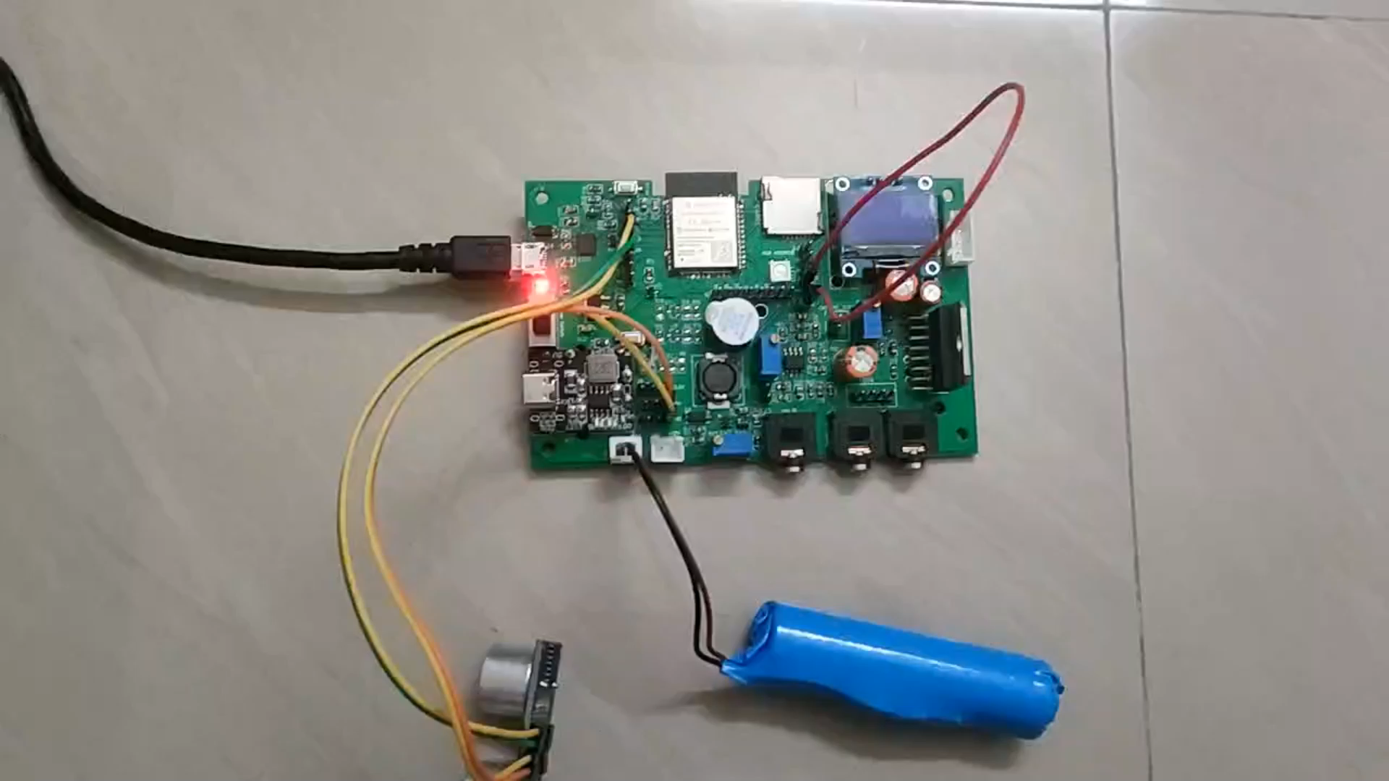
Working Video/ jpg

Slide 6
THANK YOU

